Slide 1
Understanding the Minimax Algorithm Using Connect Four
Presented by Alex Frear

Slide 2
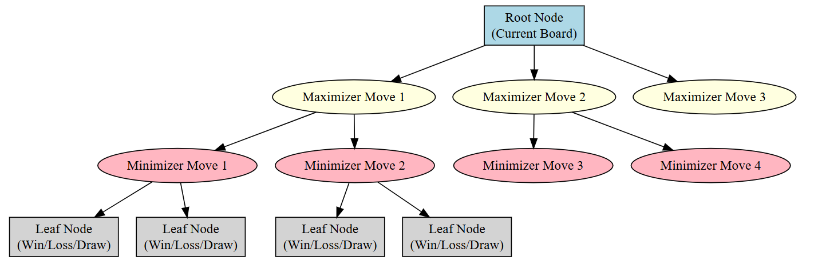
Introduction to Minimax
The Minimax Algorithm is used in turn-based, two-player strategy games.
It assumes both players play optimally to maximize their advantage.
Commonly used in AI for board games, decision trees, and strategy simulations.

Slide 3
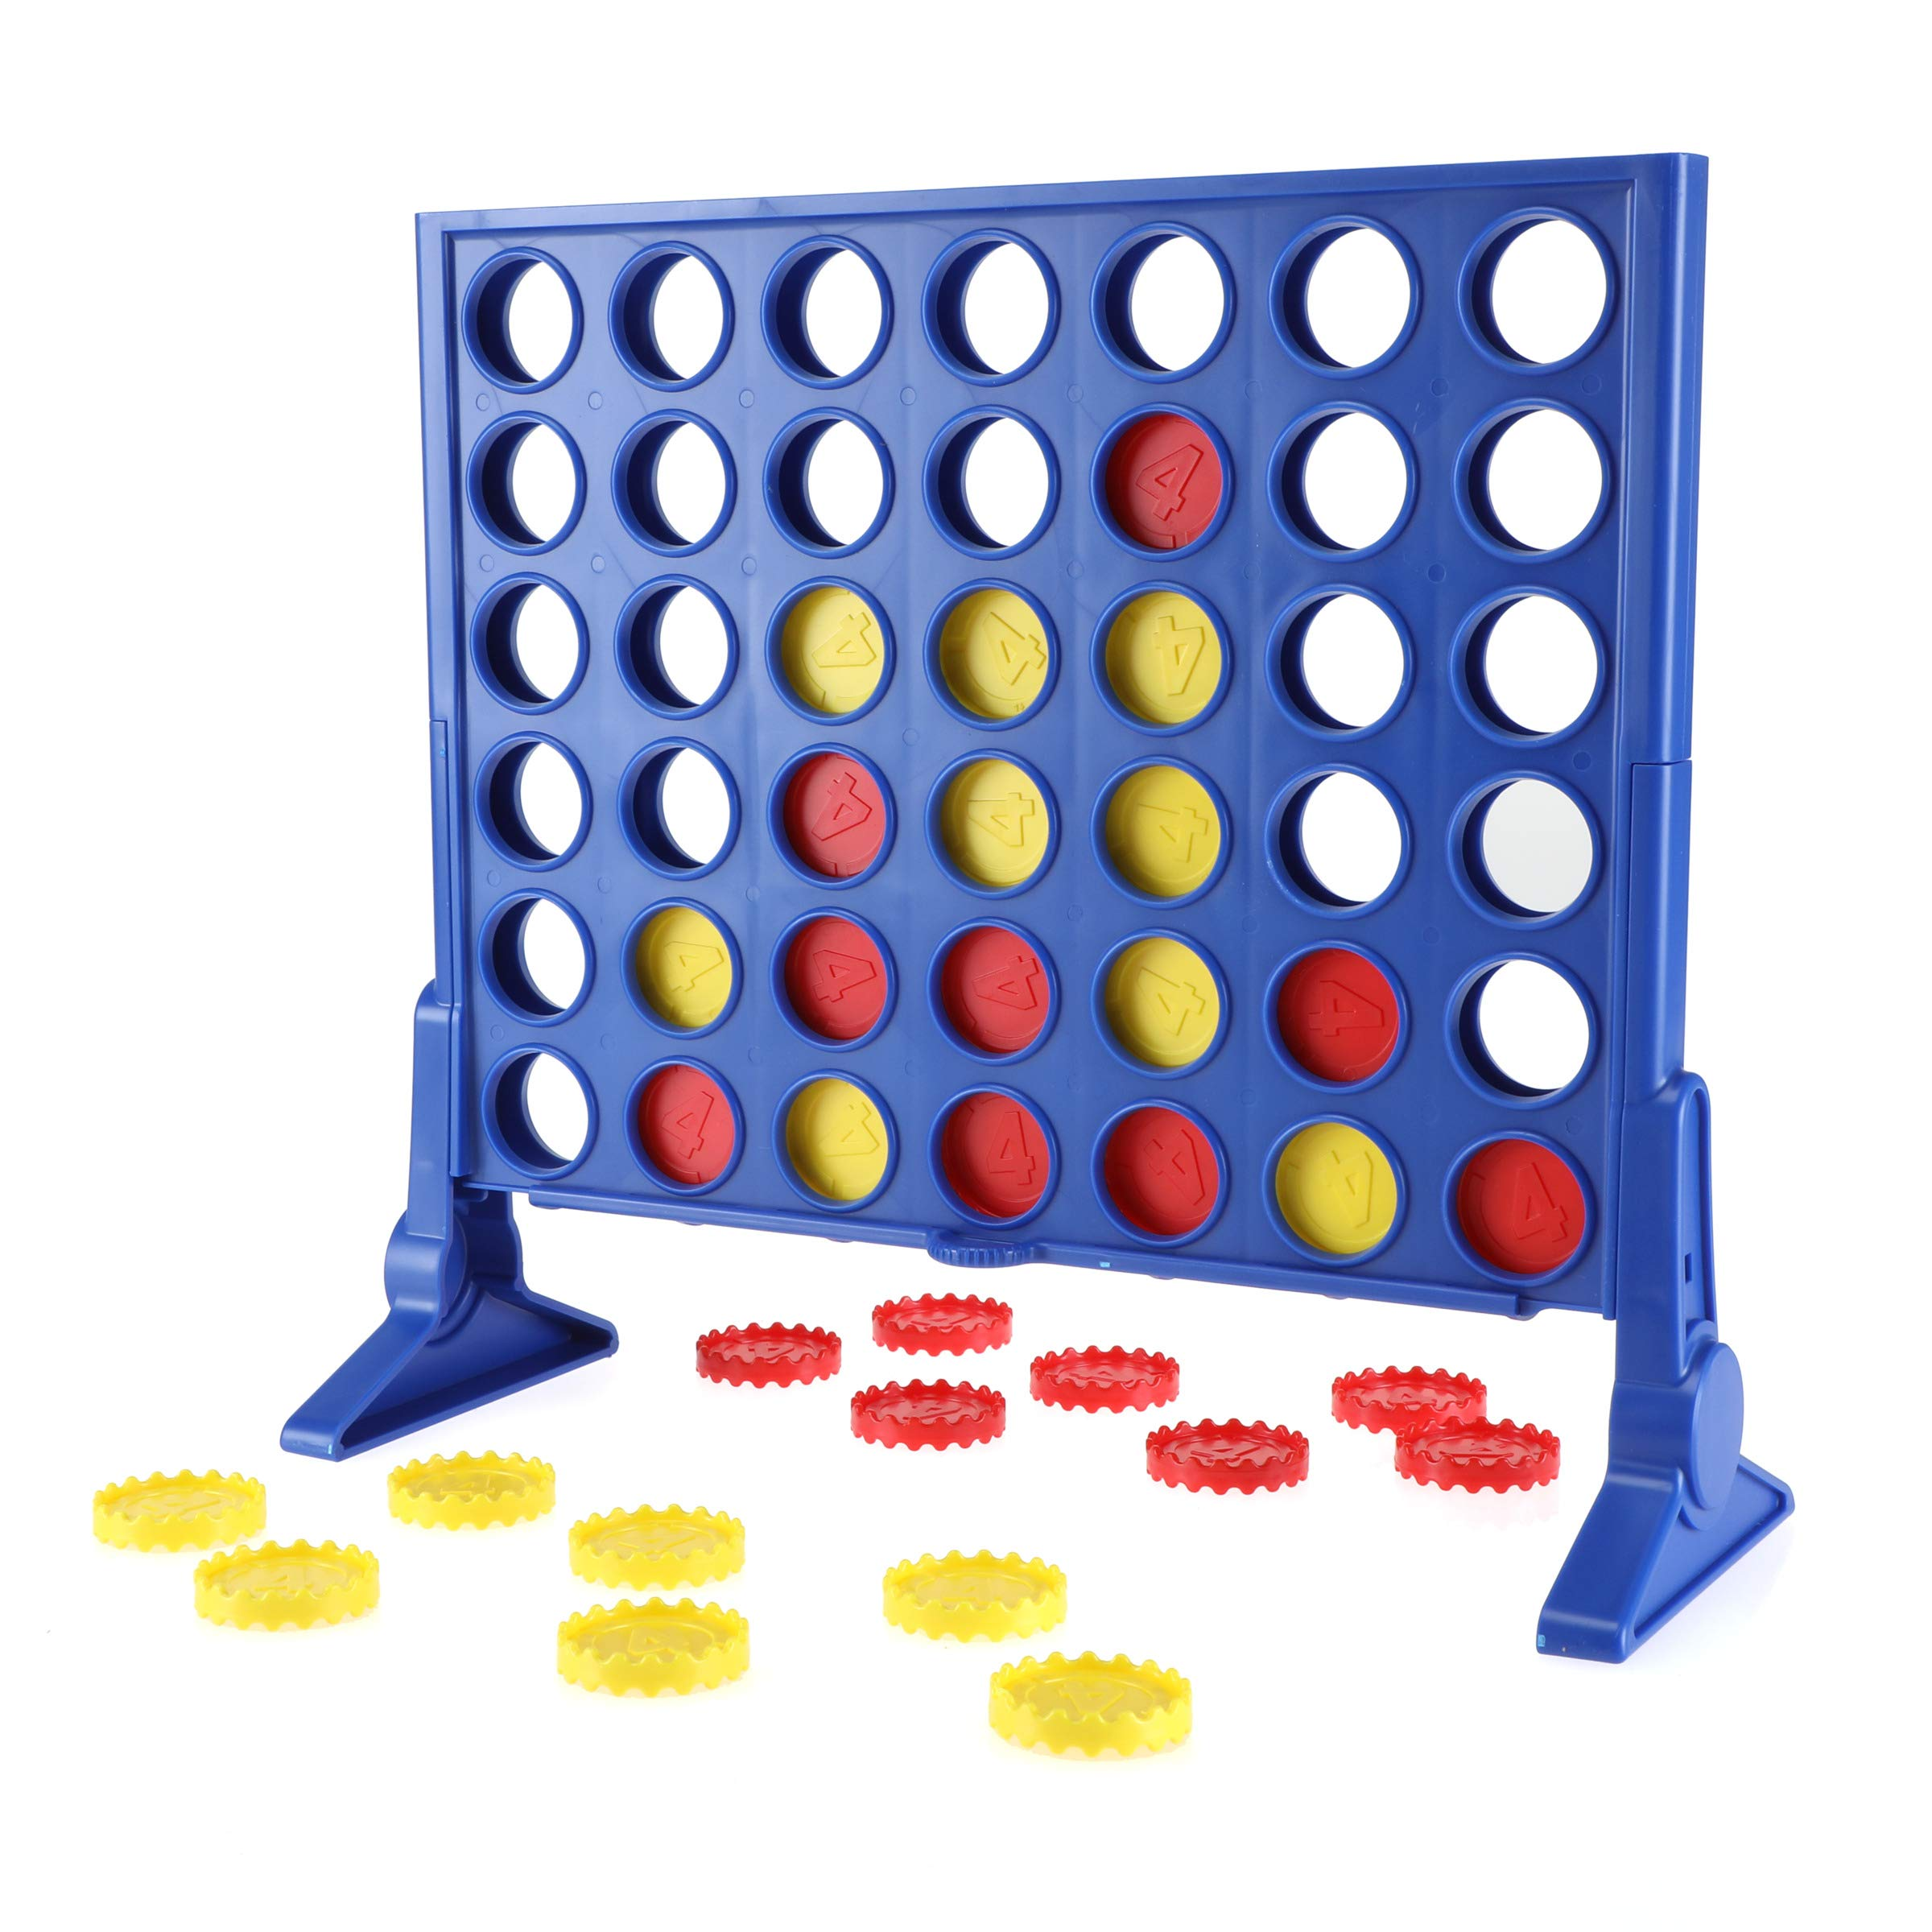
Why Connect Four?
Connect Four is a perfect example for Minimax because:
It has a fixed grid (7 columns × 6 rows).
Players take turns dropping pieces into columns.
The goal is to connect 4 pieces in a row (horizontally, vertically, or diagonally).
The branching factor (b) is at most 7 (one move per column), making it computationally
more complex than Tic-Tac-Toe.

Slide 4
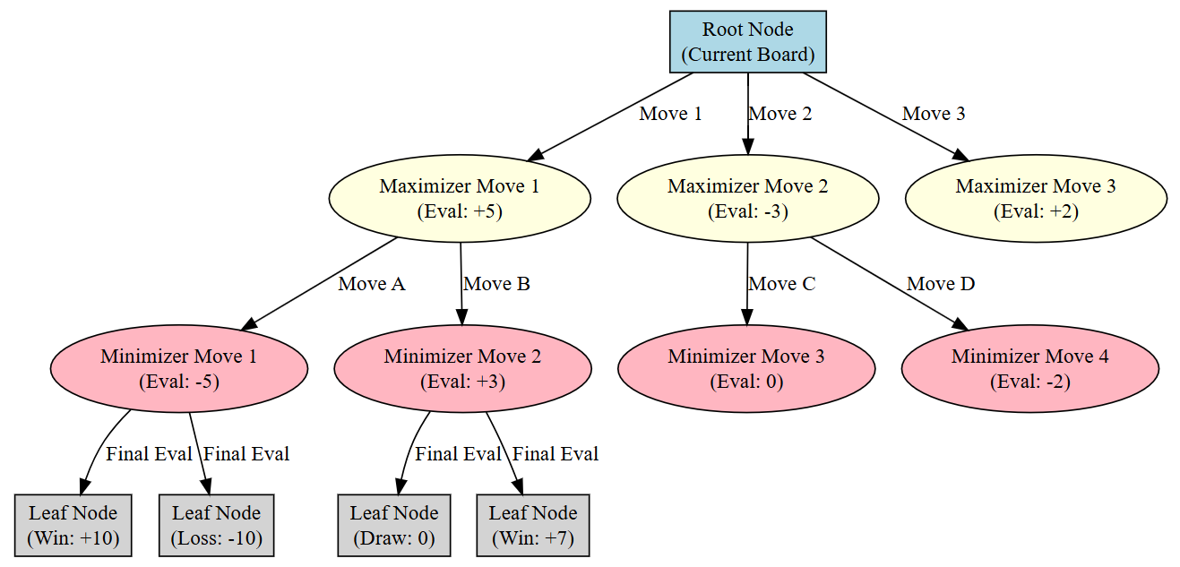
How Minimax Works in Connect Four
Generate the Game Tree
The algorithm explores all possible moves and outcomes.
Assign Scores to Terminal States
+1 for a win, -1 for a loss, and 0 for a draw.
Backpropagation
The Maximizing Player (AI) picks the move with the highest score.
The Minimizing Player (Opponent) picks the move with the lowest score.

Slide 5
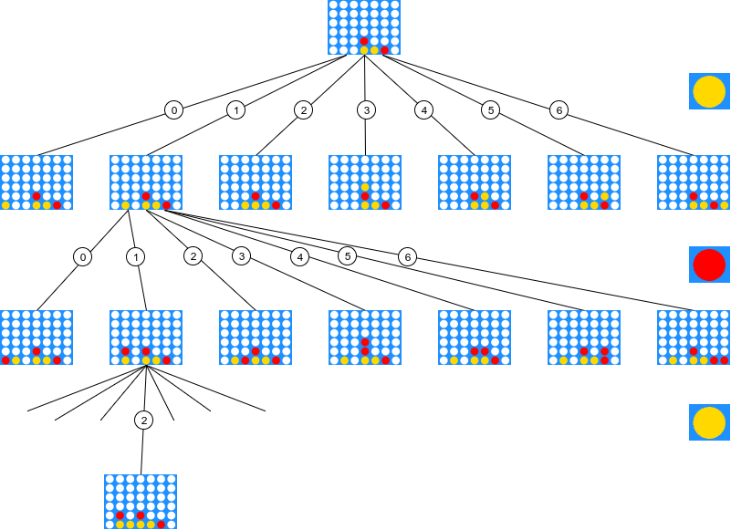
Minimax Move in Connect Four
Assume the board is partially filled.
The AI (Maximizer) must decide the best move.
The algorithm evaluates:
Winning moves first.
Blocking opponent’s winning moves.
Setting up a future win.

Slide 6
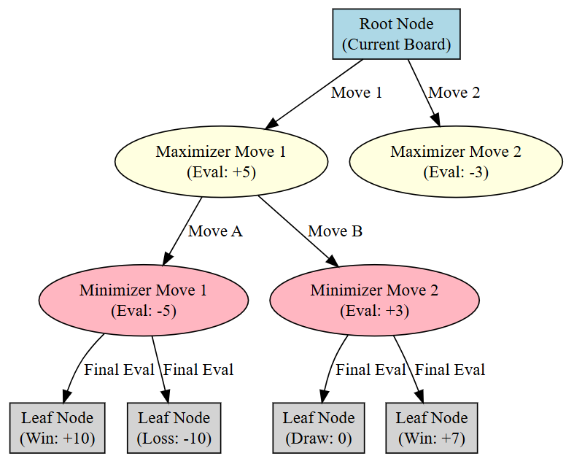
Minimax with Depth Limitation
Problem: Searching the full game tree is computationally expensive.
Solution: Limit the depth of the search.
Instead of evaluating only win/loss states, use a heuristic evaluation function to assign scores.
Example Heuristic Function:
+100 for a winning move
-100 for a losing move
+10 for a potential 3-in-a-row
-10 for blocking opponent’s 3-in-a-row

Slide 7
Alpha-Beta Pruning (Optimization)
Why is Minimax slow?
Complexity = O(b^d), where b = 7 (branching factor), d = search depth.
Alpha-Beta Pruning skips unnecessary moves
If a move is already worse than a previous move, it is ignored.
Best-case improvement: O(b^(d/2)) instead of O(b^d).

Slide 8
Big-O Complexity Analysis
Worst-case complexity (standard Minimax): O(7^d)
Best-case with Alpha-Beta Pruning: O(7^(d/2))
Why it matters:
Deep searches quickly become impractical.
AI must balance depth and processing time.

Slide 9
Real-World Applications
Where is Minimax used?
Game AI (Chess, Connect Four, Othello)
Video game decision-making (NPC behaviors)
Economic and financial decision trees
Connect Four AI Example:
The "Perfect Play AI" can never lose if it moves first.
Minimax ensures optimal moves in every situation.

Slide 10
Summary
Minimax evaluates all possible moves and chooses the best one.
Connect Four is a great example because:
Fixed grid structure.
Clear win/loss conditions.
Alpha-Beta Pruning improves efficiency.
AI using Minimax can never lose in a perfect scenario.

